Slide 1
Red-Black Trees
SAJAWAL SOHAIL
Enrolled As: BCSF11M095

Slide 2
Definition
The self-balancing is provided by painting each node with one of two colors (these are typically called 'red' and 'black', hence the name of the trees) in such a way that the resulting painted tree satisfies certain properties that don't allow it to become significantly unbalanced.
(WIKIPEDIA of course)

Slide 3
Properties
Root is always black
Black Depth is the total black from an external node.
Black depth should always be uniform.
It is Self Balancing
Each path from external node to leaf has the same number of black edges.
Red edges do not occur immediately next to each other on a path from root to leaf. Otherwise it is known as double-red error.
A red node will have both of its Childs black.
A node can not have its parent and uncle to be both red.

Slide 4
Insertion
A new Node, except root node, is always red.
After its balanced insertion double-red error is checked.
If Double-red Appears then the Parent node of newly inserted node is changed as a Black one.
If a node is declared red to black then all its siblings are also declared to be black.
And the Parent of these Siblings is declared red.

Slide 5
Deletion
Deleting a Red Leaf
Deleting a Black Parent with Only one red Leaf
Deleting a black node with red or black Childs
12
12
12
9
9
9
12

Slide 6

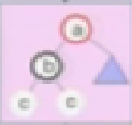

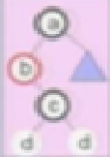
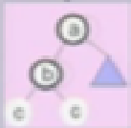
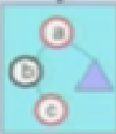

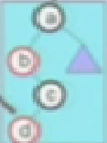
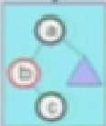
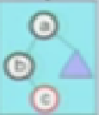

Deletion
If ‘A’ is Red
If A is Black
If B is Red
If B is Black
If B has a
Red Node
If B has
no Node
If C has
Red Node
If B has
no Node
If C has a
Red node
If C has
No Node

Slide 7
Deletion
If ‘A’ is Red
If A is Black
If B is Red
If B is Black
If B has a
Red Node
If B has
no Node
If C has one
Red node
If C has Both
Black Node
If C has one
Red Node
If B has Both
Black Node
CASE 2
CASE 1
CASE 6
CASE 4
CASE 5
CASE 3

Slide 8
CASE 1
A
C
A
C
B
C
B
A
B
A
C
B

Slide 9
CASE 2
A
A
A
B
B
B
Before h-1.
Now h

Slide 10
CASE 3
A
A
C
C
B
C
A
A
B
B
C
B
D
D
D
D

Slide 11
CASE 4
A
A
C
C
B
C
B
A
B
A
C
B

Slide 12
CASE 5
A
A
C
C
B
C
B
A
B
A
C
B

Slide 13
CASE 6
A
A
A
B
B
B
H-1
H-1
H-1
H-1
H-1

Slide 14
Advantages and Uses
It is a Self balancing tree .
Searching is easy in RBTs because they go directly to closest Black node of the key to be searched. Using the Black Depth.
Maximum and Minimum is easy to find in this tree.
It is time-Sensitive, hence very useful in real-time programs (programs that guarantee response within strict time constraints.)
It also supports O(log n) for Insertion. Deletion and searching.
They are Useful for programs which are built once and require modification after a long time e.g dictionaries.

Slide 15
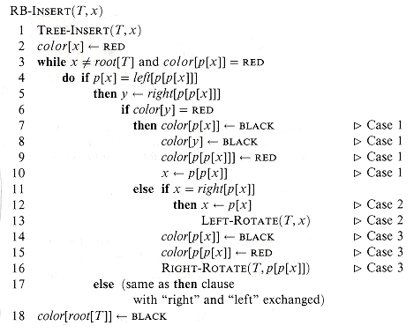

Slide 16
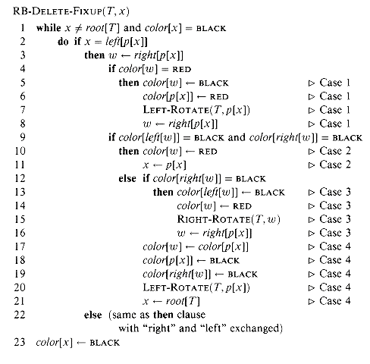
http://staff.ustc.edu.cn/~csli/graduate/algorithms/book6/chap14.htmhttp://staff.ustc.edu.cn/~csli/graduate/algorithms/book6/chap14.htm

